Slide 1

WMPP DATA PLATFORM PROGRESS
Reporting now runs on governed cloud data
The legacy network-drive dependency has been removed. Gold modelling and point-in-time reporting are the next delivery gates.
11 AUGUST 2026
Notes:
Open with the achieved outcome: the operational report is no longer dependent on a network-drive CSV source. The model now points to Fabric Lakehouse; Gold and Direct Lake remain the next gate.
[Sources]
- H:/powerbi templates/figma-plugin-figma-openai-curated-remote/outputs/WMPP-Pastel-Pink-v2-Power-BI-Theme.json
- H:/powerbi templates/figma-plugin-figma-openai-curated-remote/outputs/WMPP-brand-preview-v2.png
- https://github.com/NewRay99/fabric-csv-bronze-ingestion/blob/master/project%20X/client%20documentation/SM%20Test%20v2.zip
[/Sources]

Slide 2
EVIDENCE SNAPSHOT
The source migration is evidenced in the supplied model
Counts below are taken from the current PBIP/TMDL and report materials.
0
37
10
network or file-source
references
source tables connected
to LH_BCT_WMPP
Power BI report
pages retained
Current state: Fabric Lakehouse endpoint with a composite semantic model—not Direct Lake yet.
WMPP DATA PLATFORM
02
Notes:
The current model is composite, with DirectQuery source tables and imported derived tables. This slide demonstrates source migration, not completion of Direct Lake.
[Sources]
- https://github.com/NewRay99/fabric-csv-bronze-ingestion/blob/master/project%20X/client%20documentation/SM%20Test%20v2.zip
- https://github.com/NewRay99/fabric-csv-bronze-ingestion/blob/master/project%20X/client%20documentation/07_Semantic_Model_Changelog_v00_to_v01.md
[/Sources]

Slide 3
MIGRATION PATH
The delivery path moves from legacy files to governed Gold data
BEFORE
NOW
NEXT
01
02
03
Network-drive CSV
Fabric Lakehouse
Gold + Direct Lake
Manual dependency, Import refresh and limited governance.
Latest operational data is exposed through LH_BCT_WMPP.
Conformed dimensions, governed facts and point-in-time analysis.
WMPP DATA PLATFORM
03
Notes:
The user-described S3/object-storage landing is part of the cloud ingestion context. The semantic-model evidence specifically confirms the reporting connection to Fabric Lakehouse.
[Sources]
- https://github.com/NewRay99/fabric-csv-bronze-ingestion/blob/master/project%20X/client%20documentation/02_As_Is_Assessment_Report.md
- https://github.com/NewRay99/fabric-csv-bronze-ingestion/blob/master/project%20X/client%20documentation/04_Proposed_Solution_Architecture.md
[/Sources]

Slide 4
ACHIEVEMENTS
Four foundations are now in place
01
Cloud-source repointing
02
Report continuity
Legacy network/file-source references have been removed from the model.
The ten-page Power BI experience has been retained during migration.
03
Traceability visibility
04
Controlled ingestion
KPI IDs and requirements are linked to measures, pages and delivery status.
Archive, retry, reload and audit controls are implemented in notebooks.
WMPP DATA PLATFORM
04
Notes:
This slide separates the visible report outcome from engineering controls. The archive issue log records ten resolved defects with regression guards, while live Fabric validation remains outstanding.
[Sources]
- https://github.com/NewRay99/fabric-csv-bronze-ingestion/tree/master/project%20X/client%20documentation/notebooks
- https://github.com/NewRay99/fabric-csv-bronze-ingestion/tree/master/project%20X/client%20documentation/Power%20BI%20screenshots
[/Sources]

Slide 5
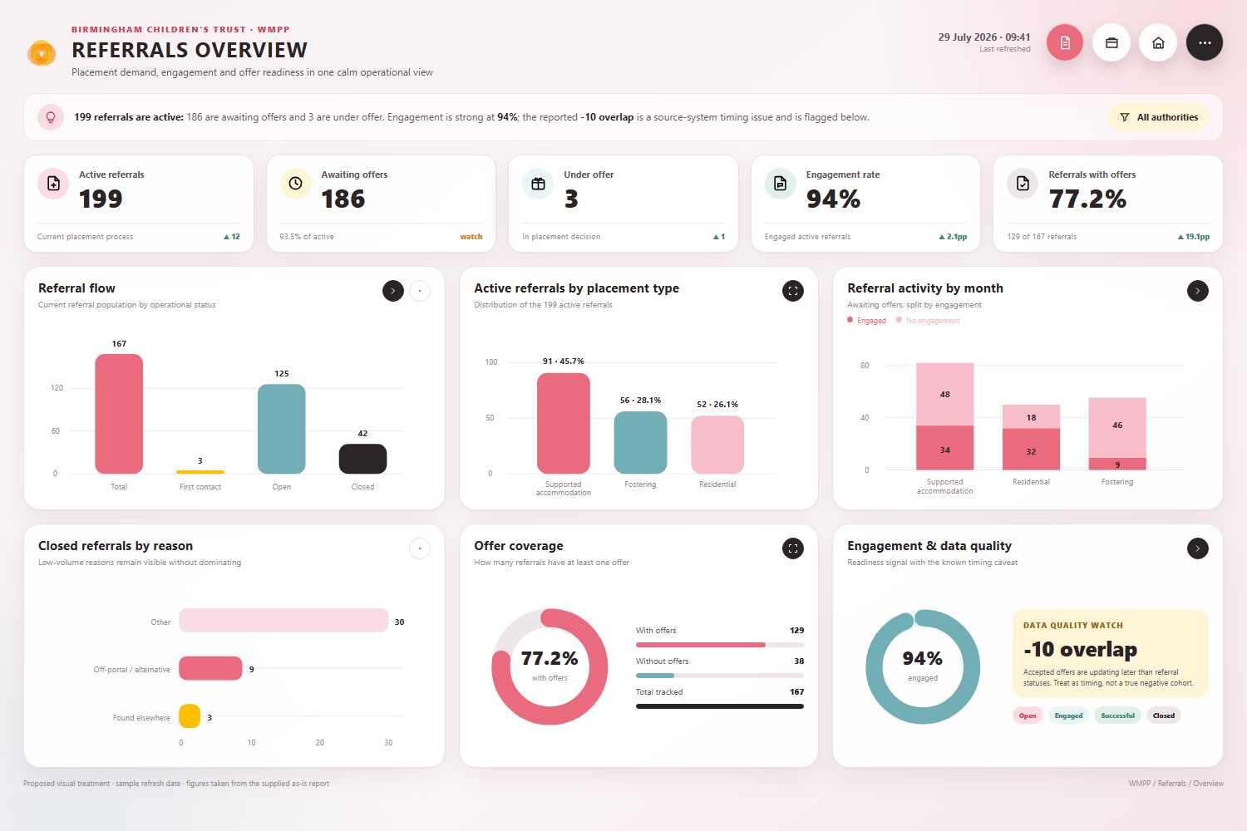
POWER BI CONTINUITY
The operational report remains usable during migration
ACTIVE REFERRALS
The refreshed report continues to provide current operational views while the dimensional model is built behind it.
This phased approach preserves reporting value first, then moves the semantic layer to governed Gold facts and dimensions.
WMPP DATA PLATFORM
05
Notes:
The screenshot demonstrates report continuity and current-data presentation. It does not prove that every target KPI has passed business acceptance.
[Sources]
- H:/powerbi templates/figma-plugin-figma-openai-curated-remote/outputs/WMPP-referrals-overview-v2.png
[/Sources]

Slide 6
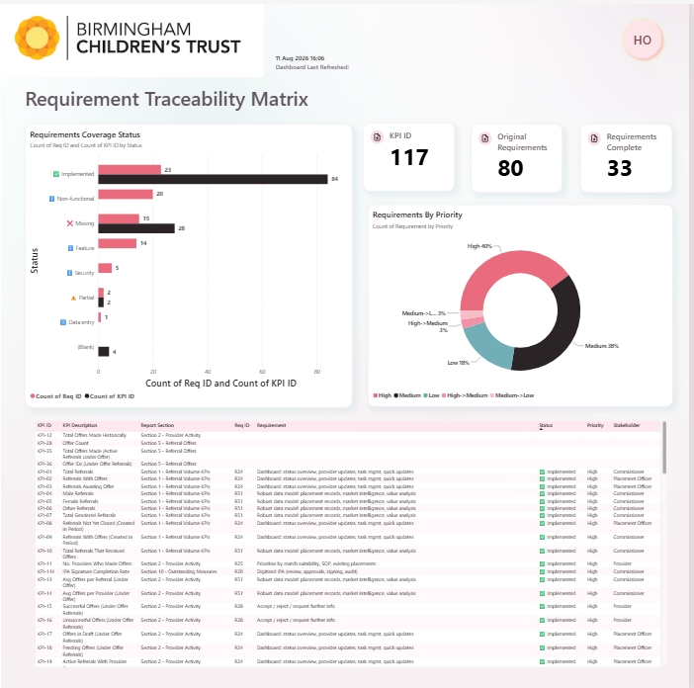
TRACEABILITY
Requirements are now connected to report delivery
VISIBLE CONTROL
The report links KPI IDs and requirements to measure names, pages, status, priority and stakeholder information.
Current view: 117 KPI IDs, 80 reportable requirements and 33 marked complete. Formal baseline reconciliation is still required.
WMPP DATA PLATFORM
06
Notes:
Formal documentation lists 87 requirements, while the report screenshot shows 80 reportable requirements. The 117 KPI target and current semantic-model measure count also require reconciliation before sign-off.
[Sources]
- https://github.com/NewRay99/fabric-csv-bronze-ingestion/blob/master/project%20X/client%20documentation/02_As_Is_Assessment_Report.md
- https://github.com/NewRay99/fabric-csv-bronze-ingestion/tree/master/project%20X/client%20documentation/Power%20BI%20screenshots
[/Sources]

Slide 7
DELIVERY TRACEABILITY
Evidence separates delivered outcomes from remaining gates
Detailed requirement mapping is retained in the supporting progress report.
Outcome | Evidence | Status | Acceptance gate
Remove network-drive dependency | No network/file refs in TMDL | Delivered | Observe production refresh
Use governed cloud source | 37 tables → LH_BCT_WMPP | Delivered | Operational handover
Preserve reporting and traceability | 10 pages + RTM screenshot | Delivered | Business regression / UAT
Bronze and Silver foundations | Audit framework + 57-table contract | Built | Execute and reconcile in Fabric
Gold dimensional model | Target design + notebook chain | WIP | Complete facts, dimensions and KPIs
Snapshots and Direct Lake | Snapshot logic + target architecture | WIP | Historical replay and semantic cutover
WMPP DATA PLATFORM
07
Notes:
The matrix deliberately distinguishes delivered, built and work-in-progress status. Static validation is not treated as production execution.
[Sources]
- https://github.com/NewRay99/fabric-csv-bronze-ingestion/blob/master/project%20X/client%20documentation/06_Statement_of_Work.md
- https://github.com/NewRay99/fabric-csv-bronze-ingestion/tree/master/project%20X/client%20documentation/notebooks
[/Sources]

Slide 8
MEDALLION DELIVERY
The platform foundation is strong; the serving layer is underway
01
02
03
BRONZE
SILVER
GOLD
Archive ingestion, audit tables, retry/reload controls and source-history handling are implemented.
A 57-table schema contract and five data-quality rules validate locally. Live reconciliation remains.
Dimensional facts, conformed dimensions, KPI logic and Direct Lake serving are the active workstream.
FOUNDATION READY
STATICALLY VALIDATED
WORK IN PROGRESS
WMPP DATA PLATFORM
08
Notes:
The newer notebook pack validates structure and compilation locally, but explicitly requires execution in the Fabric Spark/Lakehouse environment. Gold remains the active dimensional-model workstream.
[Sources]
- https://github.com/NewRay99/fabric-csv-bronze-ingestion/blob/master/project%20X/client%20documentation/fabrics%20data%20solution.docx
- https://github.com/NewRay99/fabric-csv-bronze-ingestion/tree/master/project%20X/client%20documentation/notebooks
[/Sources]

Slide 9
POINT-IN-TIME REPORTING
Monthly referral snapshots are the next user-facing capability
REPLAY
SNAPSHOT
REPORT
01
02
03
Load historical archives
Create month-end facts
Expose trend analysis
Select the canonical export for each month.
Write an AS_OF_DATE grain to the Gold snapshot fact.
Compare referral position, backlog and outcomes over time.
CODED
SIMULATED
COMING SOON
WMPP DATA PLATFORM
09
Notes:
The repository includes canonical monthly export logic, Gold fact_referral_snapshot orchestration and a local three-month simulation. Production replay and report integration remain pending.
[Sources]
- https://github.com/NewRay99/fabric-csv-bronze-ingestion/blob/master/project%20X/client%20documentation/notebooks/version%2002%2004/ARCHIVE_BATCH_PROCESS.md
- https://github.com/NewRay99/fabric-csv-bronze-ingestion/tree/master/project%20X/client%20documentation/notebooks
[/Sources]

Slide 10
NEXT DELIVERY GATE
Prove the full path in Fabric
01
Run Bronze → Silver → Gold end-to-end
02
Reconcile requirements, KPIs and measure counts
03
Repoint to Gold/Direct Lake and validate monthly snapshots
SUCCESS = UAT + RECONCILIATION + OPERABILITY
Notes:
Close on the definition of done: Fabric execution, reconciliation, UAT, performance/security evidence and support handover. Decommission the network source only after acceptance.
[Sources]
- https://github.com/NewRay99/fabric-csv-bronze-ingestion/blob/master/project%20X/client%20documentation/06_Statement_of_Work.md
- https://github.com/NewRay99/fabric-csv-bronze-ingestion/blob/master/project%20X/client%20documentation/notebooks/version%2002%2004/VALIDATION.md
[/Sources]

